Slide 1

Tellco Customer Analytics
NextHikes IT SolutionsIT Solutions
Kiran Jadoun
1

Slide 2
Business Problem & Project Objectives
Business context
Four analytical objectives
Telecom networks generate large volumes of XDR (eXtended Detail Record) data, capturing customer activity across calls, data usage and network interactions. However, raw session-level records do not directly reveal customer behavior, engagement patterns, network experience or satisfaction. This project transforms XDR data into meaningful customer-level insights to identify usage patterns, experience gaps and service optimization opportunities.
01 — User Overview
Understand the customer base through demographics, customer segments and overall usage patterns.
02 — User Engagement
Measure customer engagement using session activity, data usage, call activity and interaction frequency.
03 — User Experience
Evaluate network experience through session performance, throughput, latency and service quality indicators.
04 — User Satisfaction
Combine engagement and experience metrics to identify customer satisfaction levels and segment-level patterns.
.
:
2

Slide 3
Dataset Overview & Data Quality
The raw telecom xDR dataset contains 150,001 records and 55 columns; analysis is ultimately performed at customer level.
RAW RECORDS
RAW VARIABLES
CUSTOMERS
USABLE SESSIONS
150,001
55
106,856
148,935
Telecom xDR session records
Identifiers, timestamps, network and app metrics
Unique MSISDNs in user-level outputs
After removing records missing MSISDN / Start / End
Core data-preparation flow
Key analytical variables
Profile 55 columns & data types
Treat numerical missing values by column mean
Remove records missing critical customer/time identifiers
Detect & treat numerical outliers with IQR + mean replacement
Validate duplicates and create customer-level feature datasets
Customer: MSISDN , Handset Type
Usage: xDR sessions, duration, DL/UL traffic
Network: TCP retransmission, RTT, throughput
Applications: Social Media, Google, Email, YouTube, Netflix, Gaming, Other
Quality note: No duplicate records remain after data cleaning.
3

Slide 4
Data Preparation & Feature Engineering
Cleaning and transformation create consistent customer-level analytical datasets and features for task 1-4.
Profile
Clean
Aggregate
Standardize
Segment
1
→
2
→
3
→
4
→
5
150,001 × 55
Missing + outliers
106,856 customers
Clustering features
K-Means clustering
Derived customer-level features
Engagement
xDR sessions • session duration • total traffic
Experience
TCP retransmission • RTT • throughput • handset
Satisfaction
{Engagement Score + Experience Score}/2 → Satisfaction Score
Application
7 application data volumes + deciles + correlation + PCA
All downstream analytical datasets validate to 106,856 customers with 0 duplicate IDs and 0 missing values.
4

Slide 5
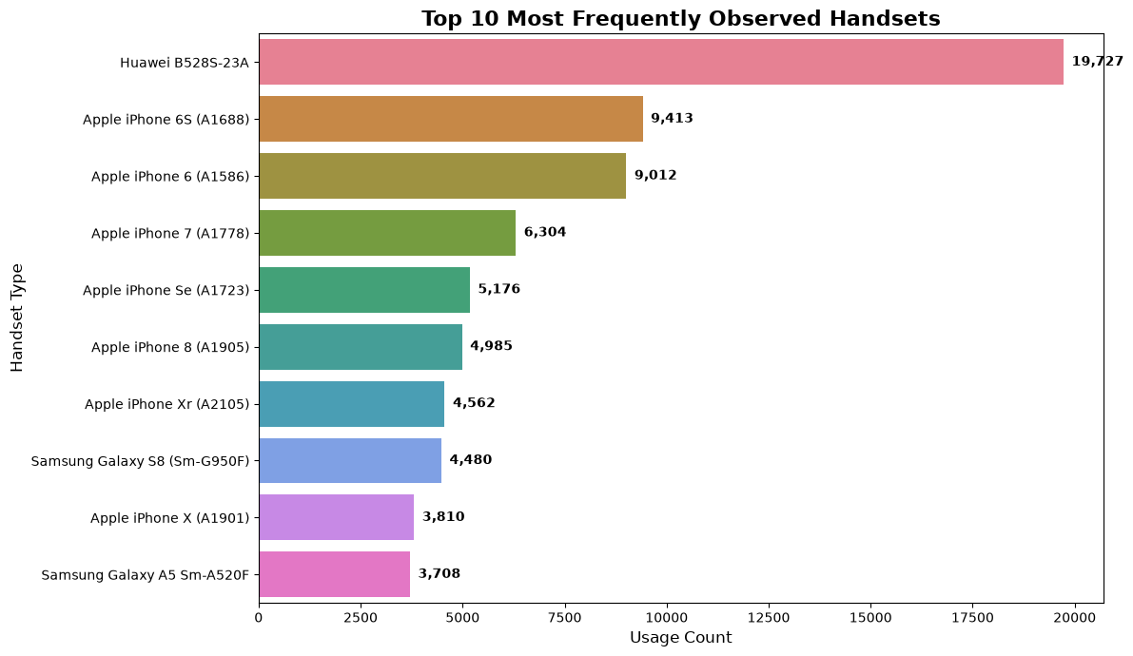
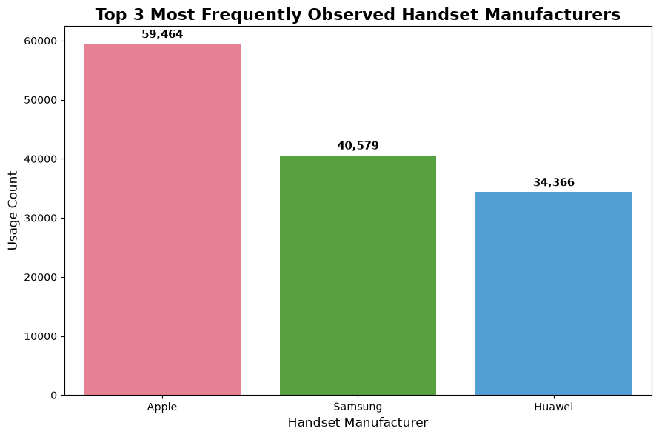
User Overview — Devices & Manufacturers
The device landscape is concentrated around three major manufacturers, with Huawei B528S-23A the most frequently observed handset.
Top 5 Handsets By Manufacturer
Apple:
iPhone 6S • iPhone 6 • iPhone 7 • iPhone SE • iPhone 8
Samsung:
Galaxy S8 • Galaxy A5 • Galaxy J5 • Galaxy J3 • Galaxy S7
Huawei:
B528S-23A • E5180 • P20 Lite/Nova 3E • P20 • Y6 2018
Top manufacturer counts
Apple 59,464 • Samsung 40,579 • Huawei 34,366 | Top handset: Huawei B528S-23A (19,727 observations)
Marketing implication: Focus device-specific campaigns and compatibility offers around the most-used Apple, Samsung and Huawei handsets.
5

Slide 6
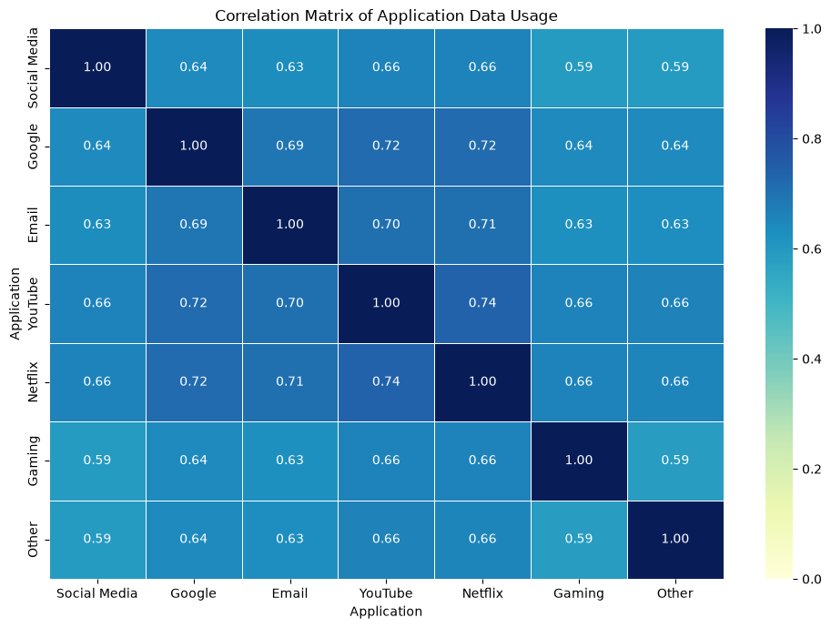
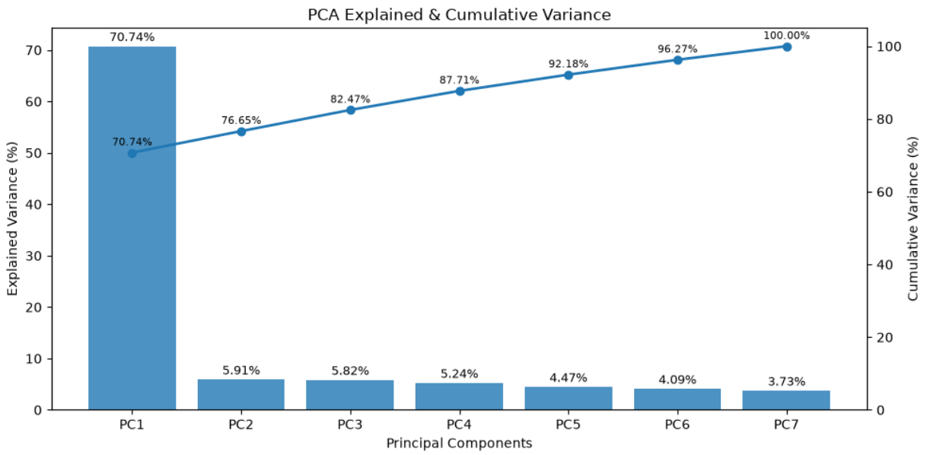
User Overview — Application Usage & PCA
Application usage is highly correlated across categories; PCA shows that one dominant component captures most of the common usage variation.
Key evidence
Gaming and Other dominate total application traffic; Gaming ≈ 6.41×10¹³ bytes and Other ≈ 6.40×10¹³ bytes.
Strongest application correlation: YouTube–Netflix r = 0.74.
PC1 explains 70.74% of variance; PC1–PC3 together explain 82.47%.
6

Slide 7
User Engagement — What We Measure
Engagement is quantified using session frequency, total session duration and total network traffic at customer level.
SESSION FREQUENCY
SESSION DURATION
NETWORK TRAFFIC
xDR Sessions
Total duration
DL + UL bytes
Number of data sessions per customer
Cumulative session time in milliseconds
Total download + upload traffic
Engagement Metrics Highlights
• Session frequency, total session duration and total traffic are aggregated at customer level.
• Maximum session frequency: 18 sessions.
• Maximum total session duration: 2.09×10⁶ ms.
• Maximum total traffic: 8.85×10⁹ bytes.
• Top customers differ across the three metrics, showing distinct engagement patterns.
• The three engagement metrics are standardized before K-Means clustering.
Standardization Before K-Means
StandardScaler was applied to the three engagement metrics.
• Standardized session frequency
• Standardized session duration
• Standardized total traffic
Standardization prevents different measurement scales
from dominating clustering distance.
7

Slide 8
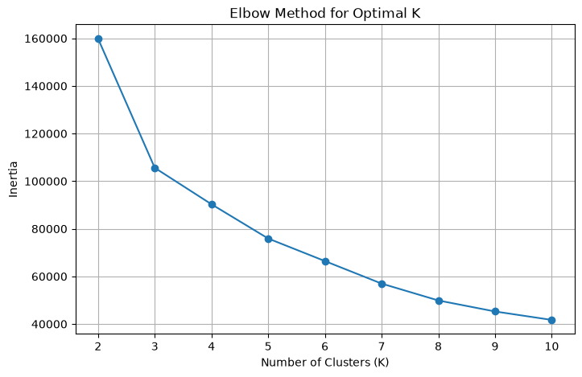
Engagement Clustering — Selecting K = 3
TASK 2
The Elbow Method indicates K = 3 as the selected value for final engagement clustering.
Elbow evidence – K =3
Inertia K=2: 159,909
Inertia K=3: 105,613
Inertia K=4: 90,316
K=3 is selected for the final engagement segmentation.
Final engagement groups
HIGH
MEDIUM
LOW
4,409
22,476
79,971
4.1% of customers
21.0%
74.8%
Labels are assigned from cluster-wise mean engagement metrics, not from the numerical cluster IDs themselves.
Source: Project notebooks (Tasks 1–4)
8

Slide 9
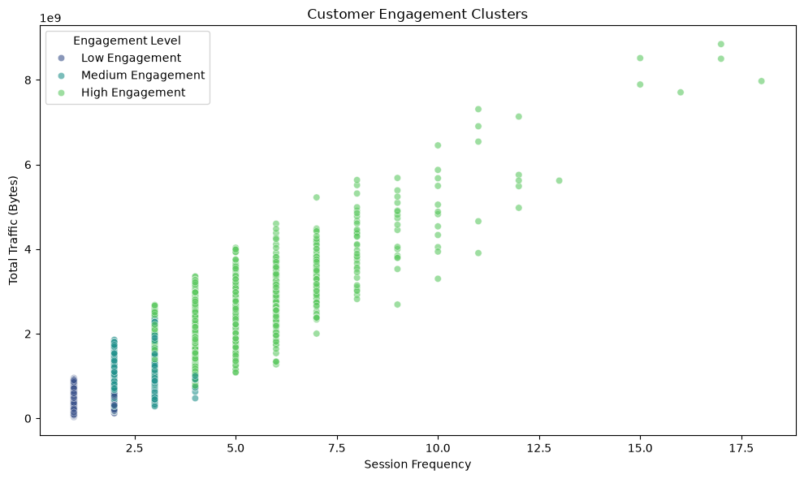
Engagement Clusters – Interpreting Customer Intensity
Cluster interpretation is based on the original, no-normalized engagement metrics.
Group
Customers
Mean Sessions
Mean Duration (ms)
Mean Traffic (bytes)
High Engagement
4,409
4.18
447,436
2.16×10⁹
Medium Engagement
22,476
2.14
194,411
1.09×10⁹
Low Engagement
79,971
1.03
94,069
4.98×10⁸
What the segmentation tells us
High Engagement has the highest average sessions, duration and traffic intensity.
Medium Engagement sits between the two groups on average engagement.
Low Engagement is the largest segment, with the lowest average values across all three metrics.
9

Slide 10
Cluster Statistics — Engagement Metrics
Non-normalized engagement metrics by High, Medium and Low engagement groups.
Group | Metric | Min | Max | Mean | Total
High Engagement | Sessions | 3 | 18 | 4.18 | 18,441
High Engagement | Duration (ms) | 85,554 | 2.09×10⁶ | 4,47,436 | 1.97×10⁹
High Engagement | Traffic (bytes) | 6.62×10⁸ | 8.85×10⁹ | 2.16×10⁹ | 9.53×10¹²
Medium Engagement | Sessions | 1 | 4 | 2.14 | 48,193
Medium Engagement | Duration (ms) | 18,235 | 5.14×10⁵ | 1,94,411 | 4.37×10⁹
Medium Engagement | Traffic (bytes) | 1.67×10⁸ | 2.51×10⁹ | 1.09×10⁹ | 2.45×10¹³
Low Engagement | Sessions | 1 | 2 | 1.03 | 82,301
Low Engagement | Duration (ms) | 7,142 | 2.45×10⁵ | 94,069 | 7.52×10⁹
Low Engagement | Traffic (bytes) | 3.32×10⁷ | 9.58×10⁸ | 4.98×10⁸ | 3.98×10¹³
KEY TAKEAWAY
High Engagement shows the highest mean session frequency, duration and traffic, while Low Engagement represents the largest customer group with the lowest average engagement across all three metrics.
Statistics are calculated on the original non-normalized engagement metrics.
9

Slide 11
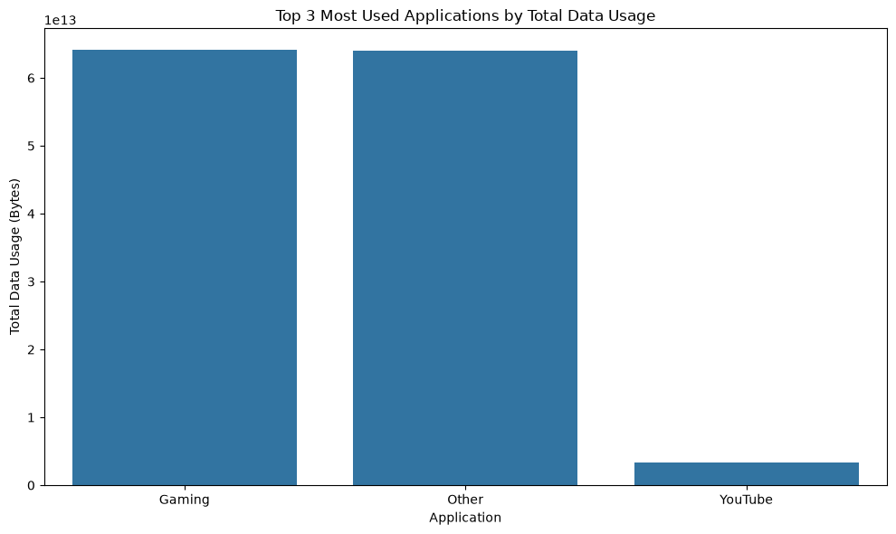
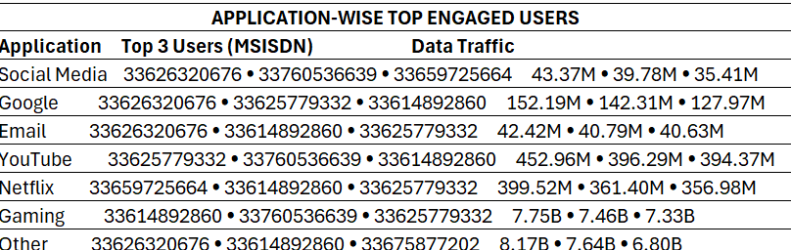
Application-Level Engagement
Gaming and Other are the two largest application traffic categories; YouTube is a distant third among the top three.
Top 3 application traffic
GAMING
6.41×10¹³ bytes
Highest total application traffic
OTHER
APPLICATION-WISE TOP ENGAGED USERS
Top 10 users were derived for each application based on total data traffic.
The table below shows a compact view of the highest-engagement users.
6.40×10¹³ bytes
Very close to Gaming
YOUTUBE
3.37×10¹² bytes
Substantially below the top two
Top 10 engaged users were computed separately for Social Media, Google, Email, YouTube, Netflix, Gaming and Other.
10

Slide 12
User Experience — Network Quality Metrics
Customer experience is evaluated using TCP retransmission, RTT and throughput, with handset type retained for handset-level analysis.
TCP RETRANSMISSION
TCP DL + TCP UL
TCP RETRANSMISSION
TCP DL + TCP UL
Combined retransmitted data (Bytes)
ROUND TRIP TIME (RTT)
(RTT DL + RTT UL) / 2
Average network response time (ms)
THROUGHPUT
(TP DL + TP UL) / 2
Average bearer throughput (kbps)
Experience Data Preparation
• Numerical experience variables: missing values replaced with column mean.
• Handset Type: missing values replaced with mode.
• IQR method used to detect numerical outliers.
• Detected outliers replaced with the corresponding column mean.
• Combined session-level metrics created for TCP Retransmission, RTT and Throughput.
• Metrics aggregated at customer level using MSISDN.
Customer-level experience features
• Average TCP Retransmission
• Average RTT
• Average Throughput
• Most frequently used Handset Type
• 106,856 customers
• 0 duplicate customer IDs
• 0 missing values
Source: Project notebooks (Tasks 1–4)
11

Slide 13
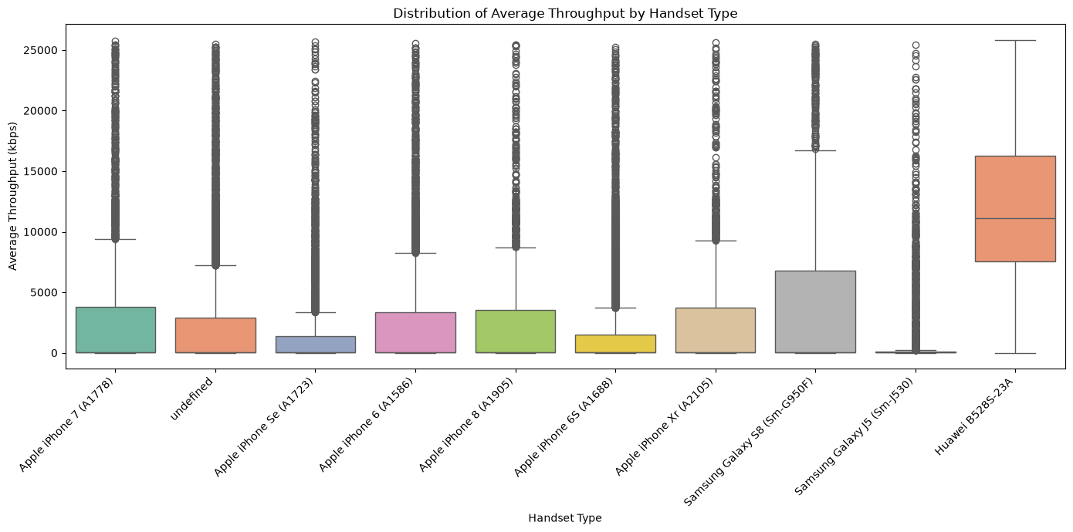
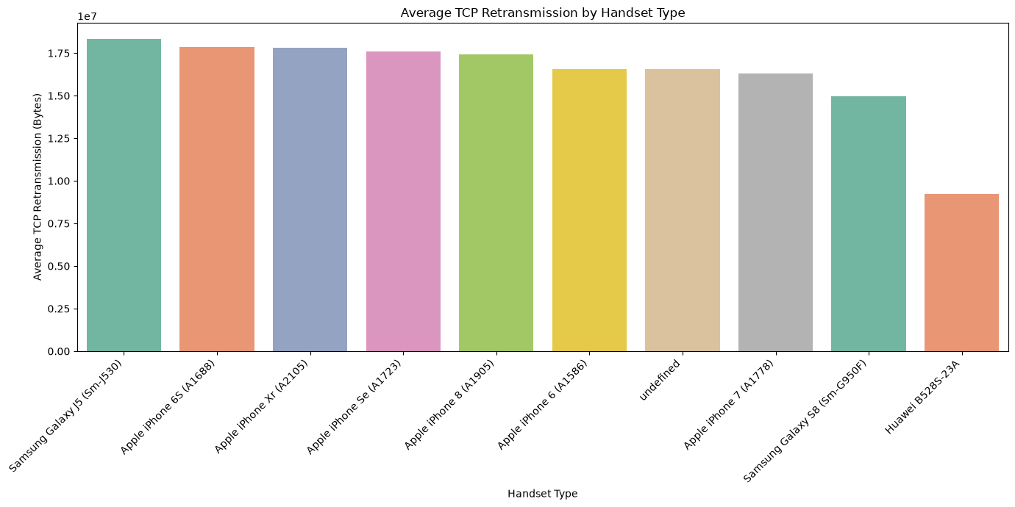
Handset-Level Experience Analysis
Observed network experience varies substantially across the most frequently observed handset types.
Key Observation — Throughput
• Huawei B528S-23A shows the highest average throughput among the selected handset types.
• Average throughput varies across handset types, indicating differences in observed network performance.
Key Observation — TCP Retransmission
• TCP retransmission levels vary across the selected handset types.
• These are descriptive handset-level differences in observed network performance; they do not establish causality.
Source: Project notebooks (Tasks 1–4)
12

Slide 14
Experience Clustering — K = 3
Customer experience is segmented using standardized TCP retransmission, RTT and throughput metrics.
CLUSTER 0
CLUSTER 1
CLUSTER 2
43,998
35,909
26,949
Mixed profile
Stronger experience characteristics
Relatively weaker characteristics
Cluster
Mean TCP Retrans.
Mean RTT
Mean Throughput
0
20.37M
21.61 ms
779 kbps
1
3.90M
41.08 ms
9,375 kbps
2
20.24M
64.13 ms
1,265 kbps
13

Slide 15
Experience Cluster Insights
TASK 3
Cluster labels are interpreted from their metric profiles, not from the numeric IDs alone.
Cluster 1 shows stronger network experience characteristics: lowest mean TCP retransmission (~3.90M bytes) and highest mean throughput (~9,375 kbps).
Cluster 0 has a mixed profile: lowest mean RTT (~21.61 ms), but high retransmission (~20.37M) and the lowest throughput (~779 kbps).
Cluster 2 shows relatively weaker characteristics: high retransmission (~20.24M), highest RTT (~64.13 ms) and relatively low throughput (~1,265 kbps).
These segments provide a basis for comparing customer engagement with network experience in the satisfaction stage.
Experience profile at a glance
TCP retransmission
20.37
3.9
20.24
RTT
21.61
41.08
64.13
Throughput
779
9375
1265
Interpretation remains descriptive: handset and cluster differences are observed patterns, not causal effects.
Source: Project notebooks (Tasks 1–4)
14

Slide 16
From Engagement & Experience to Satisfaction
Satisfaction is an analytical index derived from the two upstream scores—not a direct survey response.
ENGAGEMENT SCORE
EXPERIENCE SCORE
SATISFACTION SCORE
0.036 – 32.070
0.068 – 5.340
0.127 – 16.814
Distance from the lower-engagement reference cluster
Distance from the weaker-experience reference cluster
Average of Engagement Score and Experience Score
Analytical logic
Satisfaction Score = (Engagement Score + Experience Score) / 2
Higher score = greater distance from the selected lower-engagement and weaker-experience reference clusters.
This is a project-derived analytical measure; it should not be presented as a direct customer survey score.
15

Slide 17
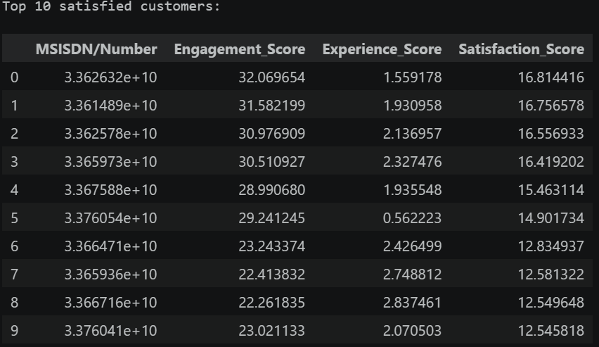
Customer Satisfaction — Top Customers & Score Distribution
The satisfaction score combines the two upstream analytical scores to rank customers and support segmentation.
Top satisfaction scores
SATISFACTION SCORE PROFILE
Mean: 1.601
Median: 1.532
75th percentile: 1.955
Minimum: 0.127
Maximum: 16.814
The top-ranked customers are driven primarily by high Engagement Scores, while Experience Scores provide an additional contribution to the combined index.
RANK 1
16.814
Engagement 32.070 • Experience 1.559
RANK 2
16.757
Engagement 31.582 • Experience 1.931
RANK 3
16.557
Engagement 30.977 • Experience 2.137
RANK 4
16.419
Rank 4 — Engagement 30.511 • Experience 2.327
16

Slide 18
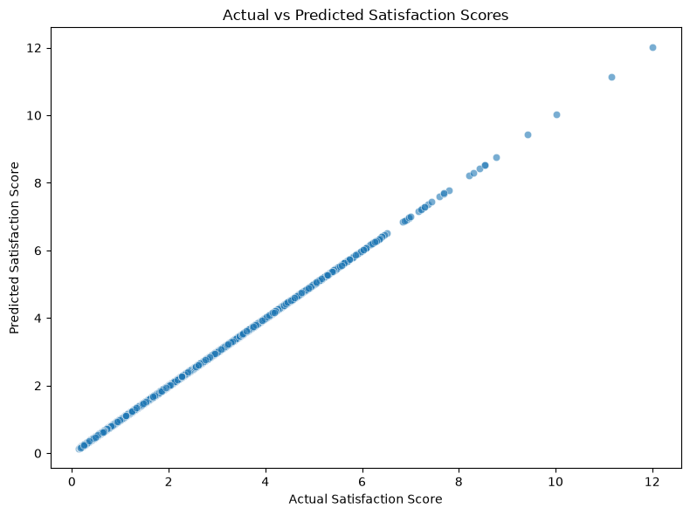
Satisfaction Clustering & Regression
K-Means creates two satisfaction-related groups; regression reproduces the mathematically derived satisfaction score.
CLUSTER 0
CLUSTER 1
37,238
69,618
Mean satisfaction 1.3549
Mean experience 0.8731
Mean satisfaction 1.7328
Mean experience 2.5482
Regression result
MSE
R²
0.0
1.0
Exact reproduction
Exact linear relationship
Actual vs predicted values align almost perfectly.
The result is deterministic because Satisfaction Score is defined from Engagement Score and Experience Score—the same predictors used in regression.
17

Slide 19
SQL Server Integration & Validation
Three customer-level analytical datasets were prepared, validated and uploaded to the TelecomAnalytics SQL Server database.
Experience
Engagement
Satisfaction
106,856 × 6
106,856 × 5
106,856 × 11
Network experience + cluster
Usage metrics + cluster
Scores + satisfaction cluster
VALIDATION CHECKS
• Customer count: 106,856 in all three datasets.
• Experience, Engagement and Satisfaction tables verified.
• Sample customer-level records validated for key analytical fields.
• Top-10 customers identified using Satisfaction Score.
• Row counts validated in SQL Server:
Experience: 106,856
Engagement: 106,856
Satisfaction: 106,856
• Satisfaction outputs validated using MSISDN, Engagement Score,
Experience Score, Satisfaction Score and Satisfaction Cluster.
SQL evidence
SELECT TOP (10)
[MSISDN_Number],
[Engagement_Score],
[Experience_Score],
[Satisfaction_Score],
[Satisfaction_Cluster]
FROM dbo.Satisfaction;
SQL validation script supplied separately; no credentials are shown in the presentation.
18

Slide 20
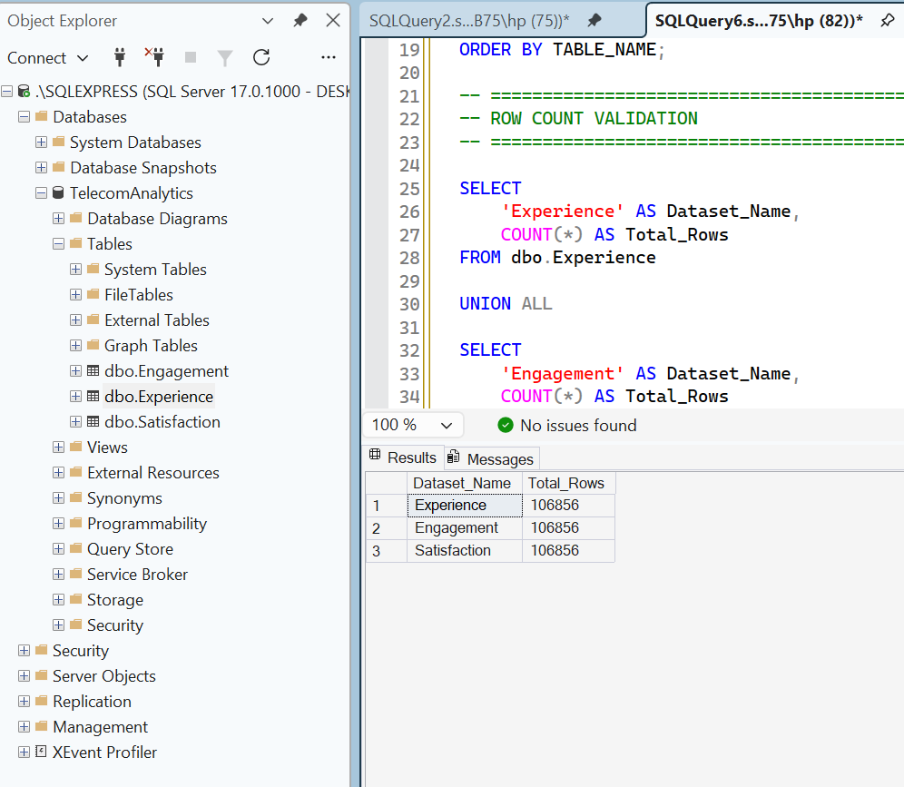
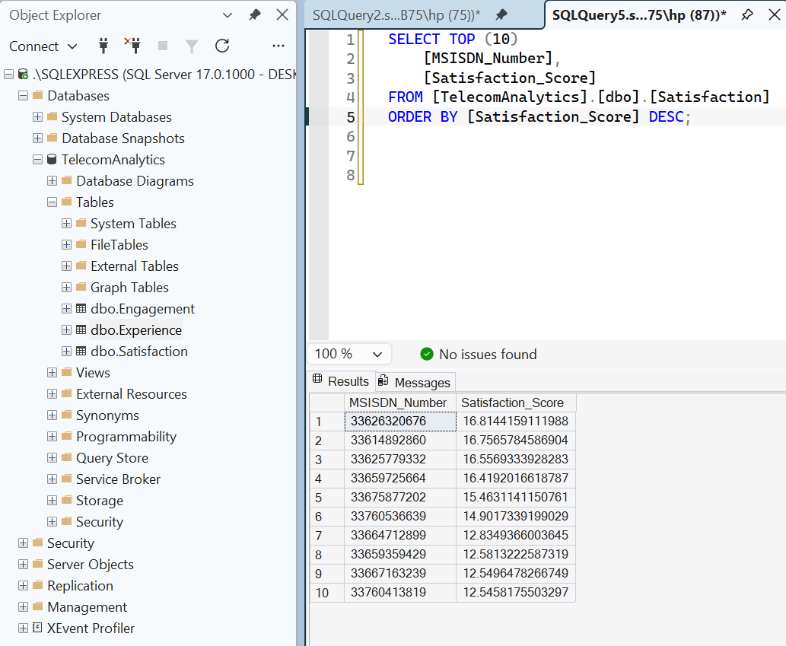
SQL Server Validation — Evidence
SQL queries validate table availability, customer-level records and satisfaction outputs.
SQL SERVER DATABASE
TelecomAnalytics database with
Experience, Engagement & Satisfaction tables.
TOP-10 CUSTOMER VALIDATION
Top 10 customers identified using
Satisfaction Score in descending order.
ROW COUNT VALIDATION
Experience: 106,856
Engagement: 106,856
Satisfaction: 106,856
SQL evidence from TelecomAnalytics database • Validation queries executed in SQL Server
18

Slide 21

Business Insights, Opportunities & Limitations and Recommendation
Translate the analytical findings into actionable areas while keeping conclusions proportional to the available evidence.
What the data shows
Opportunities
Limitations / next steps
• Most customers are in the Low Engagement segment (79,971), followed by Medium (22,476) and High Engagement (4,409).
• Gaming and Other are the dominant application traffic categories.
• Experience differs across customer clusters; Cluster 1 has the highest mean throughput and lowest mean retransmission.
• Satisfaction varies across two clusters, with Cluster 1 showing a higher average satisfaction score.
• Design targeted engagement initiatives for the large low-engagement population.
• Prioritize network diagnostics and QoS improvements for weaker-experience segments.
• Use application and handset usage patterns to guide service optimization and compatibility testing.
• Track engagement and experience jointly to identify priority customer segments.
• Satisfaction is a derived analytical index, not a survey measure.
• Regression performance is deterministic because Satisfaction Score is mathematically derived from its predictors.
• Cluster interpretations are descriptive and depend on selected features and K.
• Observed cluster and handset differences are descriptive patterns and should not be interpreted as causal effects.
RECOMMENDATION
Growth potential:
The analysis indicates identifiable growth opportunities through
customer engagement initiatives, network-quality improvements
and service optimization.
Purchase consideration:
A purchase decision should be conditional on satisfactory
financial, commercial and operational due diligence beyond
this dataset.
19

Slide 22

REFERENCES & PROJECT SOURCES
Primary Project Sources
• Task 1 — Telecom Analytics / User Overview Notebook
• Task 2 — User Engagement Analysis Notebook
• Task 3 — Experience Analytics Notebook
• Task 4 — User Satisfaction Analysis Notebook
• Project 5 — Project Guidelines / Classroom Instructions
(Nexthikes IT Solutions)
Technical Tools & Integration
• Python: Pandas, NumPy, Matplotlib, Seaborn, Scikit-learn
• SQL Server / SQLAlchemy / pyodbc integration evidence from Task 4
Thank you
20

